Slide 1
Forensic Anthropology
Biomedical Technology

Slide 2
Definitions
Anthropology- is the scientific study of all aspects of human development and interaction.
Forensic anthropology - studies the identifying characteristics on the remains of an individual.
Osteobiography – “the story of a life told by the bones”

Slide 3
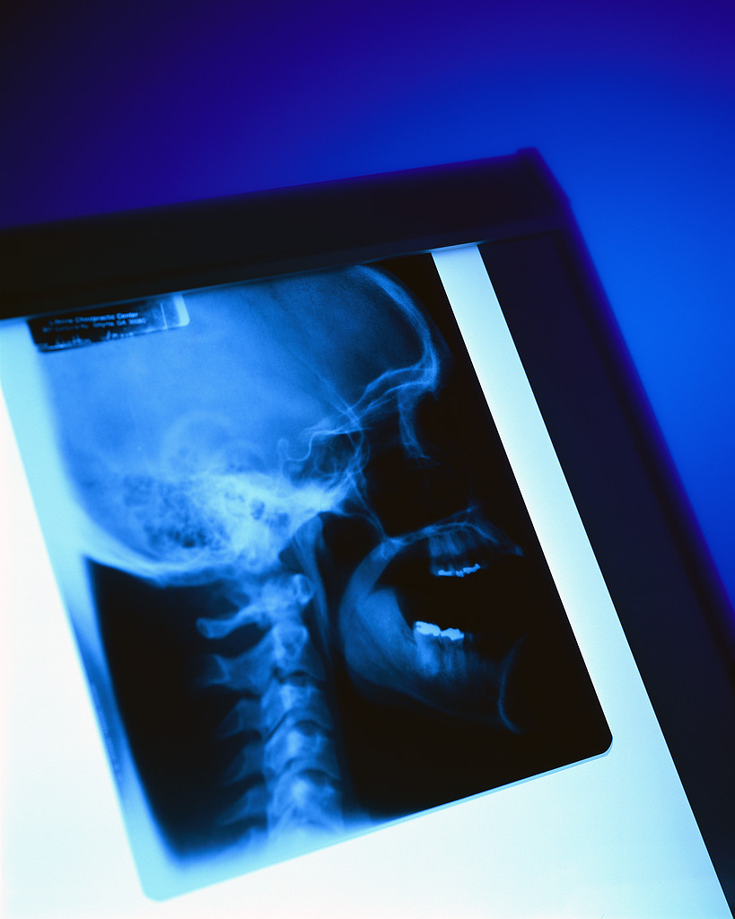
Skeletal Anatomy
206 bones
b. Man = 12 pounds, woman = 10 pounds
206 bones in the adult skeleton
The male skeleton weighs approximately = 12 lbs
The female skeleton weighs approximately = 10 lbs

Slide 4
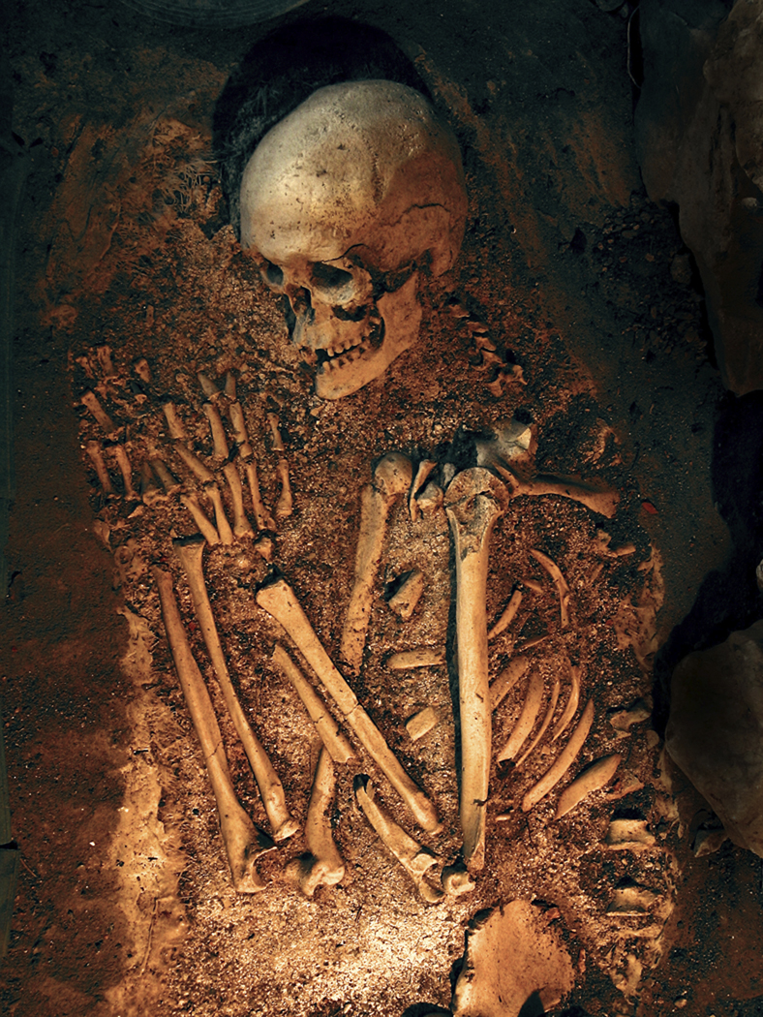
What Do Bones Tell Us?
206 bones
b. Man = 12 pounds, woman = 10 pounds
How long the person lived
Debilitation illnesses (rickets, polio, healed fractures)
Right handed or left handed
Clues to occupation
Age of person at time of death

Slide 5
How Gender is Determined…
206 bones
b. Man = 12 pounds, woman = 10 pounds
Females
General - smoother bones, femur angled (in relation to the pelvis)
Skull - rounded frontal bone and jawbone greater than 90°, eye sockets more rounded
Pelvis - subpubic angle (greater than 90°),
sacrum – shorter, broader curved outward, pelvic cavity – oval shaped

Slide 6

How Gender is Determined…
206 bones
b. Man = 12 pounds, woman = 10 pounds
Males
General - thicker, tougher and bumpy,
Skull - more massive lower sloping frontal bone & mandible at 90 °, eye sockets more squared
Pelvis - subpubic angle (less than 90°), sacrum – longer, narrower, curved inward, pelvic cavity – heart shaped

Slide 7
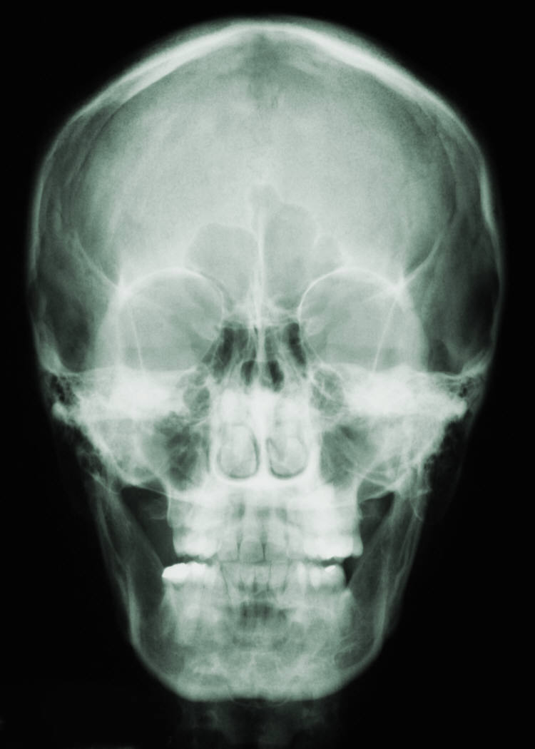
What Do Bones Tell Us?
206 bones
b. Man = 12 pounds, woman = 10 pounds
Race –
The skull and the femur give the best clues for race.
Specifically, the shape of the eye sockets, nasal spine, and width of face

Slide 8
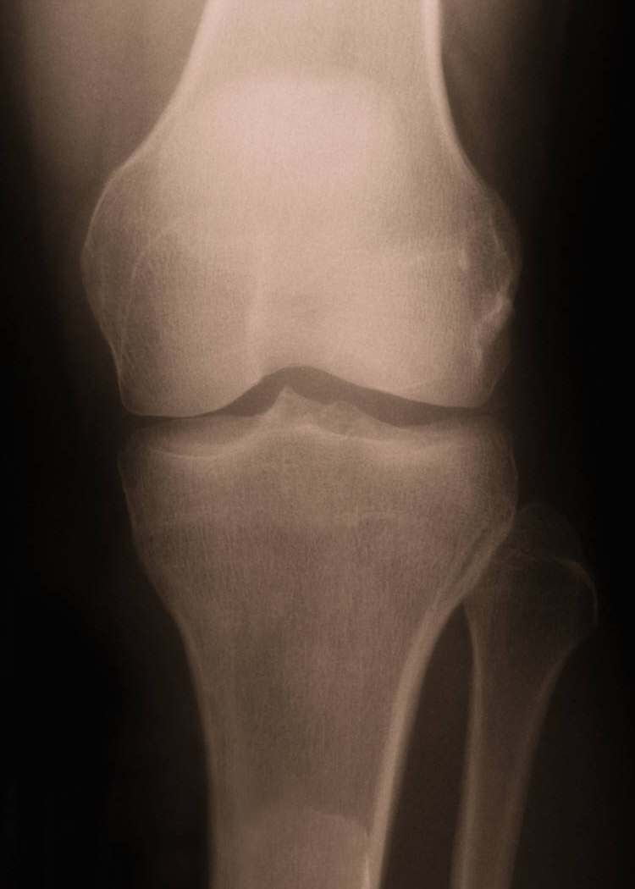
What Do Bones Tell Us?
206 bones
b. Man = 12 pounds, woman = 10 pounds
Age & Height –
Measuring the humerus and femur can help to determine the approximate height of an individual.
Age is often determined by looking for cartilage.

Slide 9
Other Applications of Forensics

Slide 10
Medical Examiner (ME)
MD
In charge of death investigations
appointed/hired by the state
required to investigate and personally view the body in all homicides, suicides, accidents, drug overdose cases and unexpected or unwitnessed deaths in his or her jurisdiction

Slide 11
Forensic Odontology
Application of dental sciences to forensics
May assist investigators/ME with identifying a decaying/disfigured body
Identify a suspect from bite marks on a victim
Doubts exist regarding the reliability of dental evidence for convictions

Slide 12
Forensic Pathology
MD
  Specialize in pathology, then forensic pathology
Carry out autopsies
  Cause/contributing factors to death
May also document injuries for legal purposes (accidents, assaults, etc.)
Collect samples to be analyzed by forensic toxicologists

Slide 13
Forensic Toxicology
Investigation of drugs/toxins in the body in cases of illegal drug use, drug abuse, poisoning and death

